Slide 1
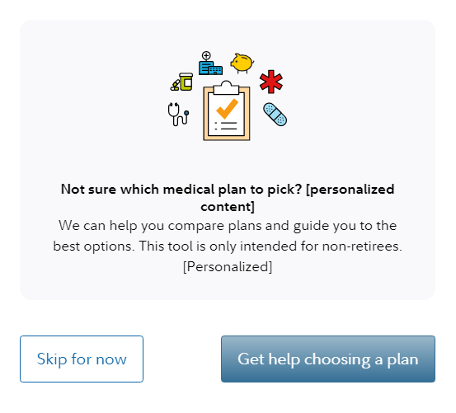
Decision Support Tool screenshots
Entry point from client NetBenefits® page:
Screenshot for illustrative purposes only.

Slide 2
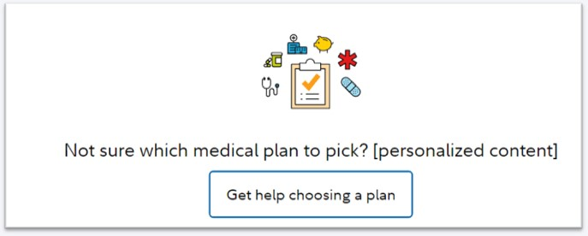
Decision Support Tool screenshots
Skip for now option or Returning to review benefits:
Not sure which medical plan to pick?
Screenshot for illustrative purposes only.

Slide 3
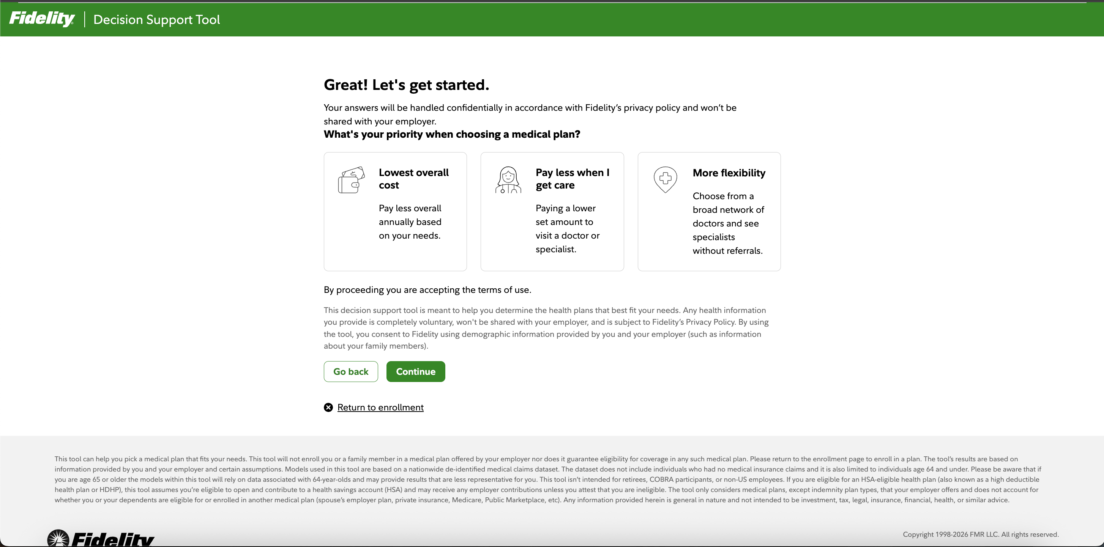
Decision Support Tool screenshots
Personal preferences page:

Slide 4
For plan sponsor use only.
Fidelity Workplace Services LLC, 245 Summer Street, Boston, MA 02210
© 2026 FMR LLC. All rights reserved.
1096489.2.0

